Slide 1
Whitnet
Brian Ault
Sam Wynsma

Slide 2
Description
Create a mock version of Whitnet’s class registration system
Students
can create accounts
Add/drop classes
Change account info
View courses registered for
Professors
View their advisees and information
Drop advisees
Remove advisees from courses

Slide 3
Logical Diagram

Slide 4
Queries
We had 14 queries for our project
Get account info
Insert new account
Find courses with certain attributes
Register/Remove student for a course
List courses student is registered for
Update account information
View advisees
Remove advisees

Slide 5
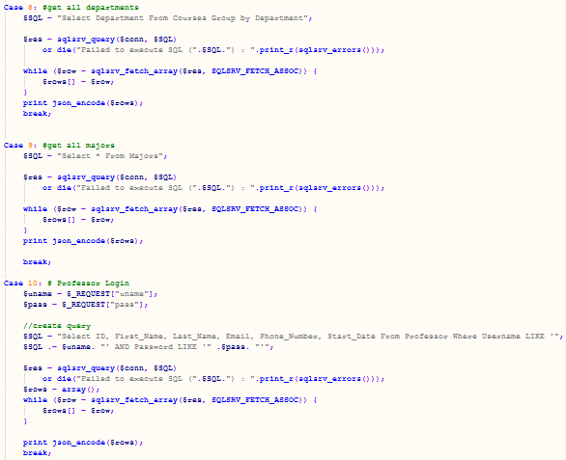
How it works
App is made in C#
App connects to database through PHP
The C# generates URL based off the queries needed
The PHP then generates the queries based on case the URL presents
PHP returns results of queries in JSON format
Decode the JSON in the app and display

Slide 6
Demo

Slide 7
The good and bad
Good
Bad
Implemented most features
App is still fast
Removed the File IO dependencies
Flexible queries
Took forever to get PHP to work
Still a few bugs
No Waitlist
Advisors do not have a lot of features we wanted them to
Get list of students they can advise
View courses they are teaching
Vulnerable to SQL injections

Slide 8
Concepts
Used
SQL inserts, deletes, updates, searches
Three tiered system
3NF form
Didn’t Use
Relational algebra
Indexing
Sorting

